Slide 1




Green Careers and Green Skills
with delivery
partners
Notes:
We are going to focus on the importance of green careers and green skills, particularly within the building and retrofit trades.
These areas/employment sectors are really important when thinking about climate change and working towards net-zero. We will look at all the key definitions as we go, so don’t worry if you don’t understand them all now.

Slide 2
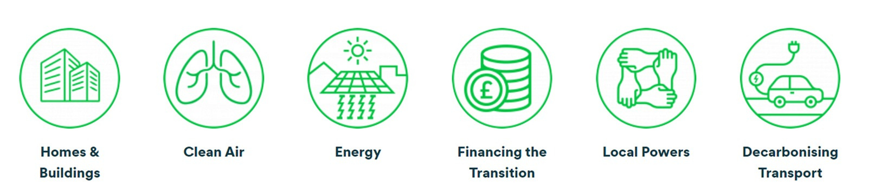
Green Skills and why they matter
“Employment in an activity that contributes to protecting or restoring the environment, including those that mitigate or adapt to climate change”
Green Skills Video
Notes:
Green skills links to all these aspects of our lives. This covers a huge range of different industries, including energy, agriculture, transportation, and waste management.
The video gives you an overview of green skills and the importance of green jobs for us, wherever you are in the world.

Slide 3

Where do Carbon Emissions come from?
Transport 28%
Energy Supply 20%
Buildings 18%
Industry 16%
Agriculture 11%
Waste & Land Use 6%
Notes:
Carbon emissions are produced from activities and resources associated with transport, energy supply, buildings, industry, agriculture and waste and land use.
For example, different forms of transport produce greenhouse gases - mainly carbon dioxide (CO2) - from burning fuel. These contribute to global warming when released into the atmosphere. Which form of transport do you think is the highest?
Walking: Zero emissions (unless you count what’s needed to produce food for energy.)
Bus: About 68-89 grams of CO₂ per passenger-km.
Small Car (petrol): Around 120 grams CO₂ per passenger-km.
Electric Car: Varies widely depending on how the electricity is generated, but averages about 53 grams CO₂ per km (if using renewable energy, this drops a lot).
Long-Haul Flight: Around 150 grams CO₂ per passenger-km (more efficient over longer distances).
You can often see the carbon footprint on food products now. Quorn – 1.3kg CO2e per kg.

Slide 4

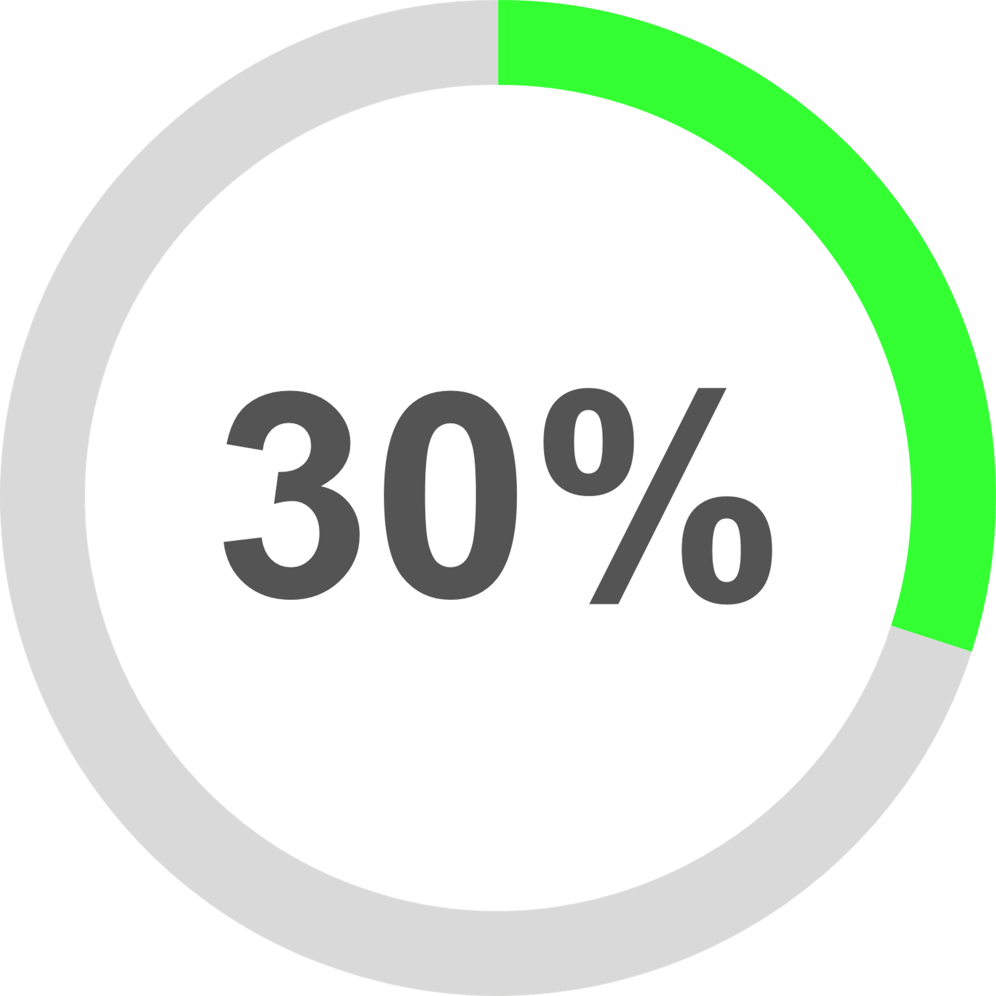

Why are Green Jobs and Skills worth thinking about?
Hundreds of thousands of new Net Zero workers are needed by 2030, especially retrofit and renewables.
Having one green skill increases the chance of getting a job by
Green and local carbon economy is already
4x larger
than the UK manufacturing sector
Green role demand has increased 87% between 2019 and 2023
Notes:
What is Net Zero? “A target of completely negating the amount of greenhouse gases produced by human activity, to be achieved by reducing emissions and implementing methods of absorbing carbon dioxide from the atmosphere.”
The target is to get to net zero by 2050 by the time you are (add age.)
Green skills, like digital skills, are part of a diverse range of jobs and the move towards a greener society is already generating a huge amount for the economy- £200 billion. Key areas are: homes & buildings, energy, making transport greener (decarbonising-electric buses/gritters/trams.)
There is an increasing demand for green roles, and having green skills boosts your ability to get a job across a lot of different sectors/areas.
Employment research (LinkedIn) indicates that individuals with green skills have a 30% higher chance of being hired, and 30% of new job listings require green skills. ￼This will only increase.
Green role demand has increased 87% between 2019 to 2023.
Not only are green skills important economically, but also so we take care of our environment and become much more aware of sustainability . (Sustainability is “meeting the needs of the present without compromising the ability of future generations to meet their own needs.”)
Our natural resources are finite and will eventually run out, such as coal, oil and natural gas, so that’s why renewable and sustainable energy is being focused on, such as solar, wind and hydro power.

Slide 5

What is Retrofit?
Notes:
Many of the houses in the UK due to how they were built and when they were built are not very energy efficient. Our boilers use oil or gas which will run out and lots of heat escapes from our roofs, walls and windows.
‘Retrofitting is also called ‘refurbishment.’ It means installing things to a building that will make it more energy efficient, such as replacing insulation, solar panels, replacing windows and doors and using efficient heating systems, such as heat pumps.
This will make the house warmer, use less important resources & save people money with their energy bills which are getting higher and higher.

Slide 6


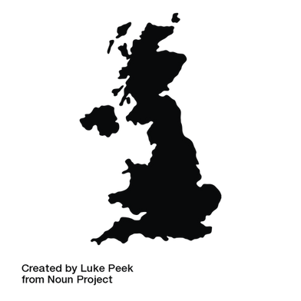







Retrofit Workforce
UK retrofit workforce development rate needs to at least triple
England needs 23,000 new retrofit workers per year
East Midlands needs 9,000 new retrofit workers per year.
250 hours per house, up to 12 disciplines
2 million homes in East Midlands — most need retrofit work carried out on them
Bolsover needs at least 170 new retrofit workers per year
~2 Million
Notes:
These figures show you how important the retrofit area is going to be for employment. It is a huge growth area - 170 new retrofit workers per year.
The UK Green Building Council estimates that around 29 million homes need retrofitting to meet the country’s net-zero commitments. Local authorities /councils are putting a lot of money into retrofitting their houses, but houses owned privately will also start looking at retrofitting.
Retrofit Workforce:
a) UK retrofit workforce development rate needs to at least triple
b) England needs 23,000 new retrofit workers per year
So, the demand for tradespeople in retrofitting is enormous and it is currently under-staffed, so there are a huge range of opportunities. The jobs are well-paid, and they all offer lots of ways to move onto new roles/ give you job progression. You can start roles with your GCSE qualifications all the way to going into a role with a degree.
So, let’s look at some of the job roles available.

Slide 7



Possible Retrofit Careers
Heat Pump Engineer
£33.5k+
Electrician
£42k+
Solar Technician
£33.5k+
Installs and maintains heat pump systems to provide efficient heating and cooling in retrofitted homes.
Installs, maintains, and repairs electrical systems in buildings and structures.
Installs, maintains, and repairs solar systems, promoting the use of renewable energy.
Notes:
These roles have titles you may have heard of before, such as engineer or technician, but focus on key roles within the retrofit trade.
So, a heat pump engineers installs and maintains heat pump systems. A heat pump is another way of heating your house, instead of a boiler or fire. It is a low carbon form of heating so it is much better for the environment.
The current average salary for the UK is £29,600, so you can see that these are all well paid jobs.

Slide 8




Possible Retrofit Careers
Retrofit Assessor
33.5k+
Retrofit Coordinator
£30k+
Plumber
£30.5k+
Installation
Specialist
£40k+
Evaluates existing buildings to identify and recommend energy efficiency improvements for retrofitting projects.
Oversee retrofit projects, ensuring compliance with standards, coordinating trades, and optimising energy performance.
Plumbers design, install and maintain systems that ensure safe drinking water, efficient heating, and reliable sanitation.
Installs wall, roof and loft insulation.
Notes:
Also, there are new roles like retrofit assessors and coordinators that offer rapid training opportunities for workers who already work in the building trades. For example, a gas boiler technician can upskill with a short course to become a heat pump installer. This gives people new career opportunities in the growing green careers world.
All these jobs can be found on the www.greencareershub.com/find-your-green-role/job-profiles. There is also a handout link at the end of this presentation.

Slide 9

Exploring examples
Retrofit careers offer competitive salaries and the potential for growth as demand for green skills increases.
Heat Pump Engineer
£33.5k+
Level 3 Qualifications
Level 3 Apprenticeships
A/T Levels:
  Building Services Engineering Construction
  Domestic plumbing and heating
  Air and ground heat source pump systems
  Low Carbon Heating Technician Apprenticeship
Vocational:
  Low Temperature Heating Systems Heat Pump Foundations
Notes:
You can see that you can get a job as a heat pump engineer in different ways using different qualifications.

Slide 10

Exploring examples continued...
Retrofit Coordinator
£30k+
You are typically expected to hold a Level 5 Diploma in Retrofit Coordination and Risk Management
Other relevant qualifications include:
  Qualified Domestic Energy Assessor (DEA)
  Level 3 Award in Energy Efficiency for Older and Traditional Buildings
  Qualifications specific to a relevant energy efficiency measure e.g., NVQ2
  CIOB Building Conservation Certification Scheme (retrofit pathway)
  Membership of a relevant professional body e.g., CIOB, RICS, CIAT, ARB
Notes:
For a Retrofit Coordinator, you will be overseeing and coordinating different aspects of the retrofit process, you would usually be expected to have a Level 5 qualification.

Slide 11

Is retrofitting something completely new?
Retrofit isn’t about reinventing the wheel, retrofit jobs are like traditional trades.
For example, a gas engineer can fit a boiler AND they can fit a heat pump.
Having an awareness of retrofit job roles allows you to see new roles/pathways open to you from design to installation.
Notes:
So even if you haven’t heard of retrofitting before, it is something to look into if you are interested in this type of work, as there are lots of new roles.
Also you or someone in your family may have their house retrofitted in future.

Slide 12








Where do I start my career pathway?
Colleges
Universities
Private training/upskiling
Notes:
There are lots of local colleges and training providers which will offer you courses and further information.
Local colleges are creating retrofitting training hubs, and they offer courses and apprenticeships across a range of construction and building service areas.
For example, Nottingham Trent University has launched a Centre for Sustainable Construction, offering certifications and contributing to research and policy.

Slide 13






Where can I work?
Electricians for Domestic, Commercial and Industrial. Family run business based in Chesterfield.
RLB is an independent global construction and property consultancy providing management and advice throughout the built environment.
Family company specialising in warm air heating/air conditioning, cellar cooling, refrigeration and solar PV. Based in Ripley.
Experience designing and installing sustainable energy systems. Based in Ilkeston.
A nationwide renewable energy installation company - with a base in Nottingham.
Retrofit decarbonisation principal contractor delivering at scale across all housing tenure types.
Notes:
Here are some examples of local companies, which you may know of or have seen their vehicles about, who work on retrofitting. All these businesses offer exciting career opportunities and are leading the way with retrofitting.
Looking at their websites will give you lots more information about the roles they offer and what they are looking for in their employees.

Slide 14






Where can I work?
Westville is a leading SME insulation and retrofit specialist, based in Shirebrook, Bolsover District.
Community Energy Orgs like Marches Energy Agency support homes reduce bills through retrofit.
One of the world’s leading heat pump manufacturers has a base in D2N2.
Energy providers across the D2N2 region, heating engineers are needed to upgrade homes and non-domestic buildings alike.
C M Ward Ltd specialises in offering electrical & renewable engineers/contractors to the East Midlands, West Midlands & Yorkshire. Based in Nottingham.

Slide 15

More information
Green Careers Hub
Retrofit Skills Centre
National Careers Service
Gov.uk - Find an Apprenticeship
Course finder:
Chesterfield College
Vision West Notts College
North Notts College
Nottingham Trent University
Notes:
You can use these websites to find out some more information about retrofitting, green careers and lots of other courses.

Slide 16
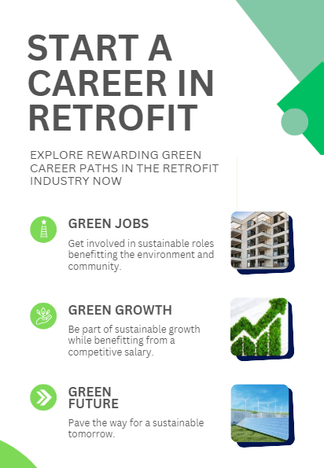

View the Handout
Notes:
This handout has lots of information about retrofitting and the roles available.
The green economy is vast and rapidly expanding and they need talented, enthusiastic people like you.
There may well be a role you could be interested in, so why not have a look at Green Careers Hub website?
Home - Green Careers Hub

